Slide 1
Graduate Thesis: WebRTC Research/Project Dennis McMeekan Committee Members: Dr. Binto George, Dr. Nilanjan Sen, Dr. Chunying Zhao
Western Illinois University

Slide 2
TABLE OF CONTENTS
01
04
Thesis Statement
Prototype Implementation
02
05
Research/Security Flaws
Adversity / Concerns
03
06
Documentation
Future Work

Slide 3
Thesis Statement
WebRTC
Due to the wide variety of technologies
used by different individuals, WebRTC has the foundation to allow a secure and simple
connection to be made by two users without installing native apps or plugins.

Slide 4
Research/Security Flaws
Overall Security
Data Integrity
IP Leaks
With online Peer-to-Peer connections becoming the norm, it is vital to develop security standards for a WebRTC based application.
One way to ensure the data being transmitted is secure, is to provide covert channels using image filtering.
A highly known issue with WebRTC is IP leaks. This can be combatted with the implementation of a Distributed Hash Table server.

Slide 5
Documentation
Survey of WebRTC Architecture
Survey of WebRTC Security
Distributed Hash Table Server
A breakdown of WebRTC Architecture, providing a base understanding of Project Implementation.
A breakdown of WebRTC Security concerns, with a committee analysis on what should be expanded upon.
A detailed explanation on how it would be possible to replace the current WebSocket Server, with a simple DHT Server representation.

Slide 6
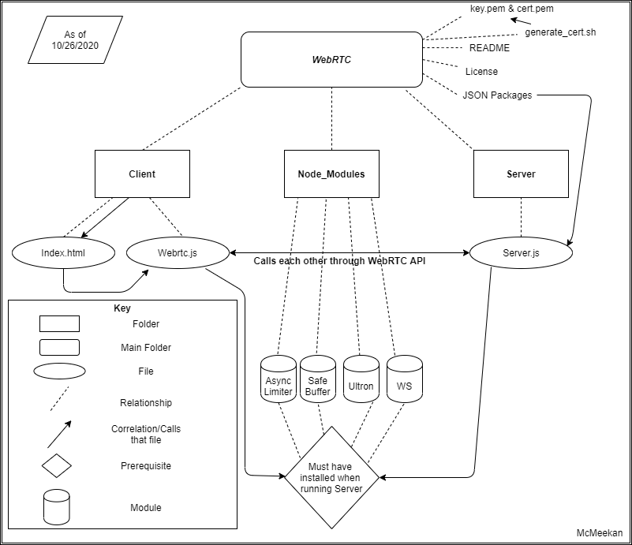
WebRTC Architecture
Simple WebSocket Server
Index.HTML – Client Connectivity
WebRTC.JS – Simulating a Peer-to-Peer Connection
Double Click to Read

Slide 7
WebRTC Security
Importance of WebRTC Security
Real Time Image Filtering
Project Work
Double Click to Read
Project Repo: https://github.com/dmcmeekan9/WebRTC-GraduateThesis

Slide 8
DHT Server Implementation
Current Approach
New Approach
Implementation
Double Click to Read

Slide 9
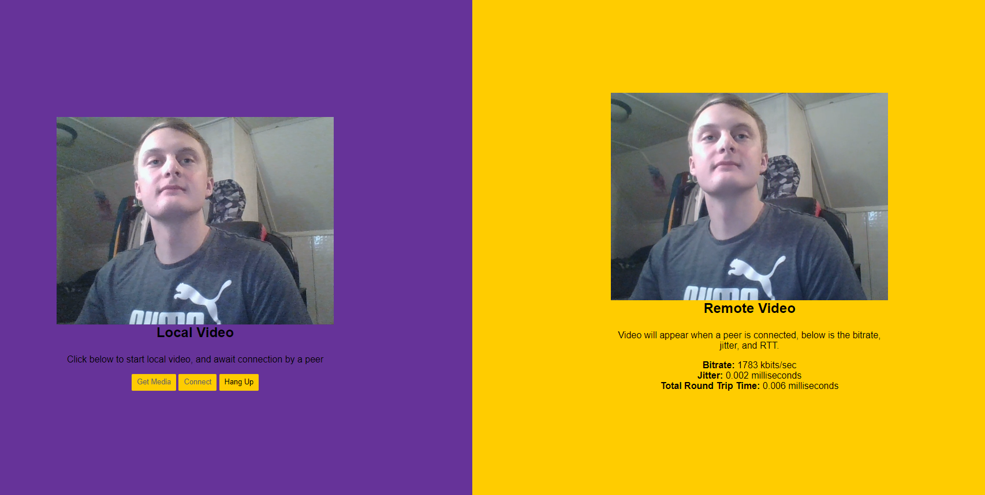
Case One Peer Connection w/o Covert Channels
1) Takes Video Input, establishes a Peer Connection
2) Outputs to Remote Stream
Averages:
- Bitrate: 1128 kbits/sec
* Low: 1008
* High: 1248
- Jitter: 0.003 milliseconds
* Low: 0.001
* High: 0.005
- RTT: 0.009 milliseconds
* Low: 0.006
* High: 0.012

Slide 10
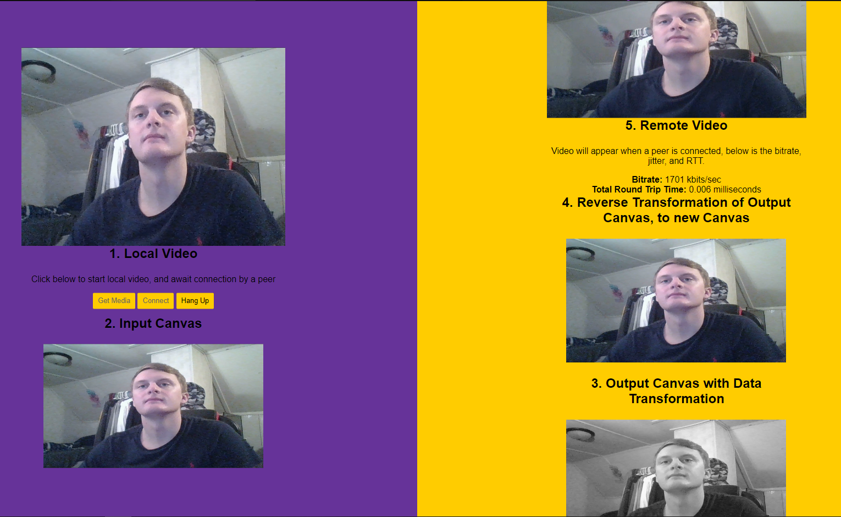
Case Two Peer Connection w/ Covert Channels using Image Filtering
1) Takes Video Input and puts data to the First Canvas
2) Performs a data transformation, then outputs to a Second Canvas, then establishes a Peer Connection
3) Remote Connection senses the data transformation, reverses the transformation, and then outputs to the Remote Stream
Averages:
- Bitrate: 1643.5 kbits/sec
* Low: 1385
* High: 1902
- Jitter: N/A
- RTT: 0.0305 milliseconds
* Low: 0.021
* High: 0.040

Slide 11
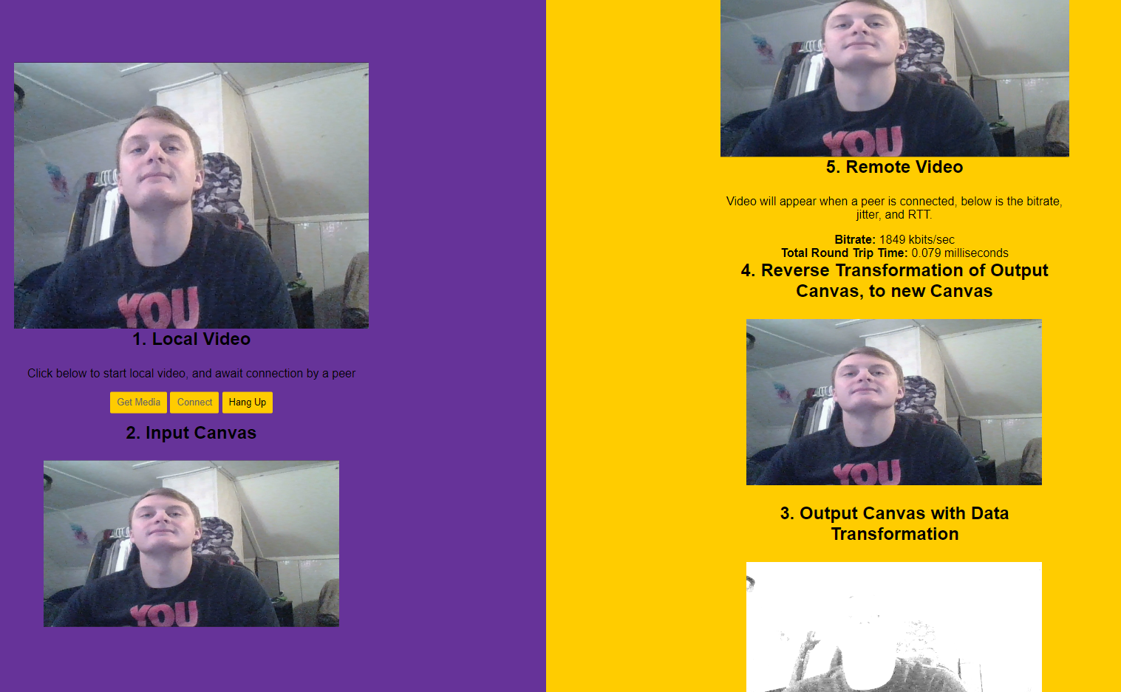
Case Three Peer Connection w/ Covert Channels introducing Random Transformations
1) Takes Video Input and puts data to the First Canvas
2) Performs a random data transformation, then outputs to a Second Canvas, then establishes a Peer Connection
3) Remote Connection senses the random data transformation, reverses the transformation, and then outputs to the Remote Stream
4) This simulates data channel control by an administrator.
Averages:
- Bitrate: 1651 kbits/sec
* Low: 1328
* High: 1974
- Jitter: N/A
- RTT: 0.019 milliseconds
* Low: 0.010
* High: 0.028

Slide 12


Results
Case Three:
Similar results as Case Two, we see an increase in Bitrate, but a decrease in RTT speed.. Although when adding element of randomness, it seems RTT stabilized more effectively.
Case Two:
Increase in Bitrate, but a decrease in RTT speed .. I believe data is being transferred faster, but taking longer due to transformations.
Conclusion:
Concluding all the results, it is valuable to use covert channels with image filtering in comparison to a more simple WebRTC application. Appllcation does lose some speed, but gains data integrity.
Performed locally to simulate, numbers are inflated.

Slide 13
Adversity / Concerns
Time
Bit Representation / User Input (Randomness)
Change of Course
Learning Curve
Beyond advancements in new languages, learning curve in development was extremely difficult.
Extensive amount of work put in each week, still feel that many routes to take to improve content and security protocols. It would have been nice to have the opportunity to fully implement a DHT Server.
After immense exploration and testing, pixel manipulation occured to be the best route of attack.

Slide 14
Change of Course
Original Emphasis
WebRTC API
WebRTC Source Code
Final Implementation
New Emphasis
MPEG Data Encryption and Authentication
JavaScript / HTML5
C Programming
Lack of Experience and Time
Concern of a Project being implemented within 2/3-month period .. Limitless amount of C Source Code
Data Integrity and IP Leaks

Slide 15
Future Work
DHT Server Implementation
Personal Project
Thesis Implementation
Possibility of future work by another student aiming to accommodate a thesis or dissertation.
Quite possible that expanding upon these two security features, a complete list of documentation and certifications could be established.
Combining all work previously discussed, writing and development must begin immediately.

Slide 16
Thanks so much for your hard work, committment, and dedication!

